Slide 1



Kubernetes Security
A Blueprint for Hardening Clusters in Production
A Comprehensive Technical Guide for DevOps & Cloud Engineers

Slide 2

Why is Kubernetes inherently vulnerable out of the box?
THE LARGE ATTACK SURFACE
By default, Kubernetes prioritizes usability over security. Many distributions ship with permissive settings to help developers get started quickly, but these same settings are dangerous in production.
The complexity of K8s means more moving parts to secure: from the API server and etcd to the network overlays and individual pod runtimes. Without hardening, a single compromised container can potentially lead to a full cluster takeover.

Slide 3






THE CIS BENCHMARK STANDARD
How do we define a "hardened" cluster?
What it is
Automated Scanning
Level 1 vs Level 2
The CIS Kubernetes Benchmark is the industry standard for secure configuration. It provides hundreds of specific, actionable checks for your control plane and nodes.
Tools like kube-bench can automatically scan your cluster against these benchmarks and provide a report on what needs fixing.
Level 1 is essential for all environments. Level 2 is "Defense in Depth" for highly sensitive environments where performance might be traded for security.

Slide 4
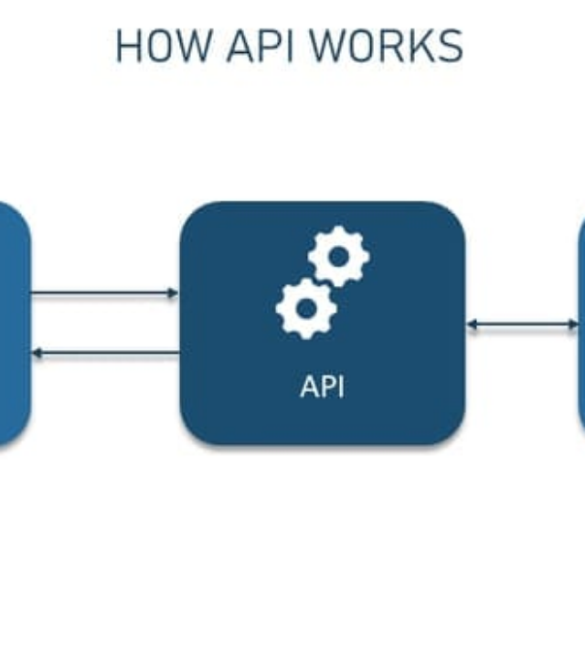
How do we lock the front door of our cluster?
API SERVER HARDENING
The API Server is the brain of the cluster. If it's exposed, your cluster is gone. Step one is disabling anonymous authentication.
Disable Anonymous Auth: Ensure --anonymous-auth=false is set to prevent unauthenticated access.
Audit Logging: Enable verbose audit logs to track who did what, when, and where.
NodeRestriction: Use this admission controller to limit what a Kubelet can modify.

Slide 5



ETCD ENCRYPTION AT REST
What happens if an attacker accesses your database?
Protecting the Secret Store
All cluster state, including your Secrets, is stored in etcd. By default, this data is unencrypted on the disk. If someone gets access to the etcd volume, they have your passwords.
Implement an EncryptionConfiguration object using providers like aescbc or kms (recommended for production). This ensures that data is encrypted before it hits the disk.

Slide 6



RBAC & LEAST PRIVILEGE
Who really needs cluster-admin access?
Role-Based Access Control (RBAC) is your primary defense against lateral movement. The golden rule is Least Privilege: grant only the permissions required for the specific task.
Avoid Wildcards
Service Accounts
Never use "*" in ClusterRoles. Be explicit about verbs (get, list, watch) and resources (pods, deployments).
Default service accounts often have too much power. Disable auto-mounting tokens if the pod doesn't need to talk to the API.

Slide 7
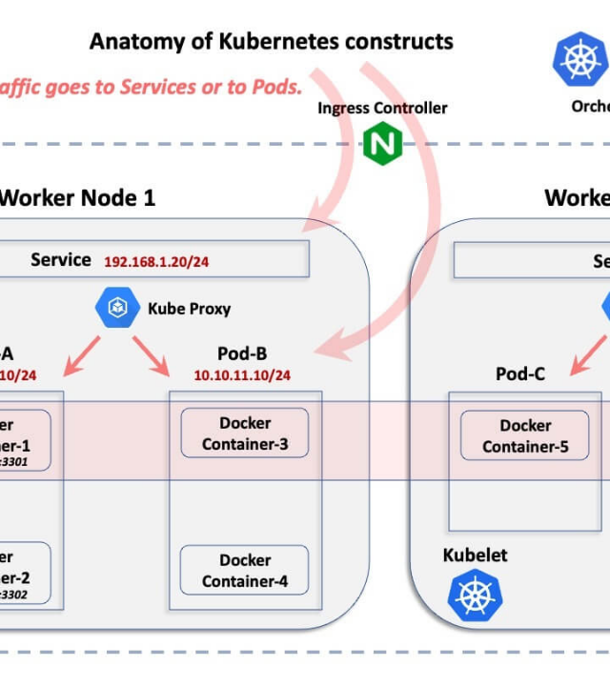
How do we stop risky pods from even starting?
POD SECURITY ADMISSION
Replacing the deprecated Pod Security Policies (PSP), Pod Security Admission (PSA) is the new built-in way to enforce standards.
Level | Description
Privileged | Unrestricted. Allows known privilege escalations.
Baseline | Prevents known escalations. Minimal restrictions.
Restricted | Highly restricted. Best practice for prod workloads.
Apply these via namespace labels: pod-security.kubernetes.io/enforce=restricted.

Slide 8


NETWORK ISOLATION
Can your frontend talk to the database without permission?
In a default K8s setup, any pod can talk to any other pod across the entire cluster. This is an attacker's dream for lateral movement.
Zero Trust
Visualizing Flow
Implement a "Deny All" Ingress and Egress policy by default for every namespace. Only explicitly allow the traffic you know is legitimate.
Use Network Policies to restrict traffic between tiers (e.g., UI → API → DB) and prevent pods from accessing the Cloud Metadata API.

Slide 9
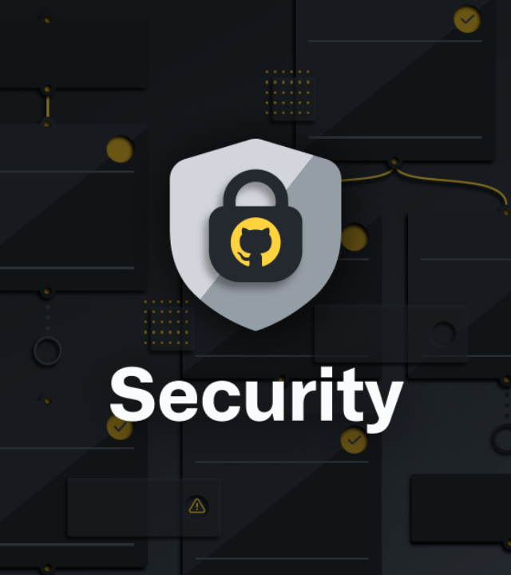
Do you know what's inside that container?
SUPPLY CHAIN SECURITY
Image Signing: Use tools like Cosign to sign your images and verify them at admission time.
Vulnerability Scanning: Scan images in your CI/CD pipeline and in your registry for known CVEs.
Admission Webhooks: Block any image that hasn't been scanned or isn't from a trusted internal registry.

Slide 10






RUNTIME DEFENSE: FALCO
How do we detect an attack in progress?
Anomaly Detection
Real-time Response
Falco uses eBPF to monitor system calls at the kernel level. It alerts on suspicious behavior like a shell being spawned in a pod or a sensitive file being read.
By integrating Falco with your SIEM, you can trigger automated responses—like killing a compromised pod—immediately upon detection.

Slide 11


PUTTING IT TOGETHER: LAYERED DEFENSE
How does this all fit together in production?
Layer 1: Code & Image
Layer 2: Cluster Config
Layer 3: Workload
Layer 4: Runtime
Scanning, signing, and minimizing base images (Distroless).
API hardening, etcd encryption, and RBAC lockdown.
Pod Security Admission and Network Policies.
Continuous monitoring and anomaly detection with Falco.
Security is a process, not a destination. Harden every layer.

Slide 12
FREQUENTLY ASKED QUESTIONS
Q: Is etcd encryption performance-heavy?
Q: How often should I run kube-bench?
A: The overhead is negligible for most clusters, but using a KMS provider adds some latency to Secret operations.
A: At least weekly, and ideally after every major cluster upgrade or configuration change.
Q: Should I use Pod Security Policies?
Q: Do I need a Service Mesh for security?
A: No, PSP is deprecated. Move to Pod Security Admission (PSA) or policy engines like Kyverno/OPA.
A: Not strictly, but meshes like Istio simplify mTLS and complex network policies at scale.

Slide 13
Thank you for joining the session on Kubernetes Hardening.

