Slide 1

Observability
Engineering
From Metrics → Insights → Faster Debugging
METRICS • LOGS • TRACES • SLOs

Slide 2
PART I
The Paradigm Shift
Moving beyond simple monitoring to truly understanding complex system behavior in real-time.

Slide 3



MONITORING VS OBSERVABILITY
Monitoring (WHEN)
Observability (WHY)
Focuses on known failure modes using predefined thresholds. It tells you that something is broken right now.
Focuses on unknown failure modes through data exploration. It allows you to ask why a system is behaving a certain way.
→
Dashboards & Alerts
→
Rich telemetry exploration
→
Threshold-based triggers
→
Context-heavy debugging
→
Focus on symptoms
→
Focus on causality

Slide 4
PART II
The Three Pillars

Slide 5






THE TELEMETRY FOUNDATION
Metrics
Logs
Traces
Aggregated numeric data over time. Low overhead, excellent for long-term trends and alerting.
Discrete events recorded as text. High detail, perfect for understanding local execution context.
The lifecycle of a request across services. Essential for microservices and bottleneck detection.

Slide 6

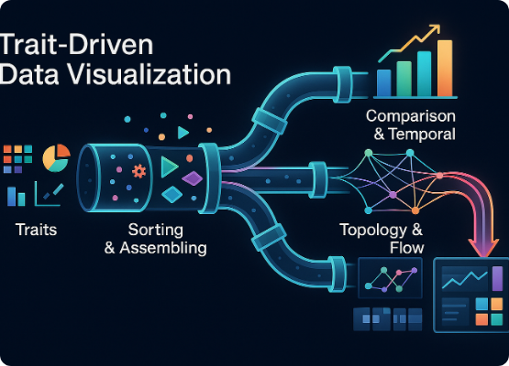
DISTRIBUTED TRACING
Mapping the Journey
Traces connect the dots between isolated services. By assigning a unique ID to every incoming request, we can visualize the entire call chain.
→
Identify latency bottlenecks
→
Visualize service dependencies
→
Pinpoint exact failure points in complex chains

Slide 7
PART III
Strategic Frameworks

Slide 8
SIGNAL SELECTION GUIDE
Framework | Primary Signals | Best Use Case
RED | Rate, Errors, Duration | Inbound Request Monitoring (APIs)
USE | Utilization, Saturation, Errors | Infrastructure & Hardware Resources
GOLDEN | Latency, Traffic, Errors, Saturation | User-facing Service Health (SRE)
Choosing the right framework ensures you collect the data that actually matters for your specific stack.

Slide 9
THE COST OF RELIABILITY
The 99.99% Challenge
4.3
To achieve four nines of availability, your total downtime allowance is incredibly slim. Observability is the only way to meet these targets by reducing detection time.
→
99.9% = 43.8 minutes/month
→
99.99% = 4.38 minutes/month
Minutes Downtime / Month
→
99.999% = 26 seconds/month

Slide 10
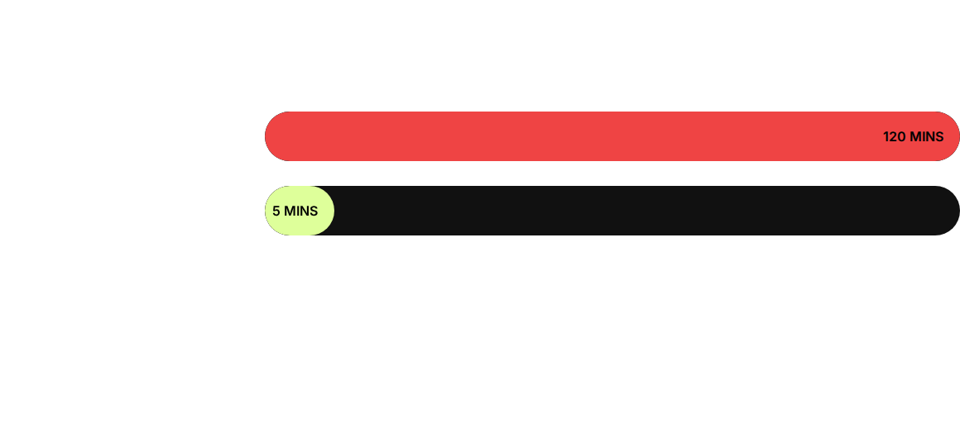
MTTR REDUCTION
Mean Time To Resolution (MTTR) is the primary metric for engineering efficiency.

Slide 11
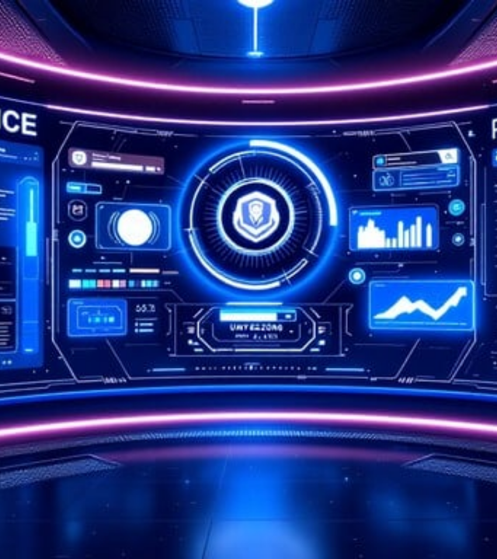
MODERN WORKFLOW
The Debugging Loop
In a modern observability environment, debugging shifts from guessing to analyzing. We use rich context to isolate failure domains instantly.
→
Alert triggers with trace context
→
Explore spans to find the slow service
→
Fix the root cause in minutes

Slide 12
Questions?
Ask better questions. Get better answers.

