Slide 1

Commit to Customer
The Journey of a Modern Deployment Pipeline

Slide 2




The Risk of Manual Deployment
Slow & Expensive
High Error Rate
Manual verification and hand-offs between teams create bottlenecks, delaying value delivery by days or weeks.
Human interaction with production systems is the #1 cause of outages. "Snowflake" servers lead to inconsistent environments.

Slide 3

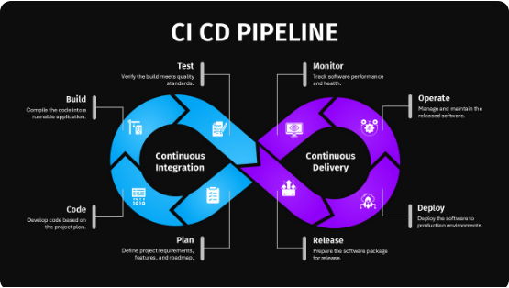
Defining the Automated Pipeline
A deployment pipeline is an automated implementation of the process for getting software from control to your users.
It acts as a safety filter: Every change must pass a series of automated gates. If it fails any gate, the journey stops immediately, providing fast feedback to the developer.

Slide 4
The Full Pipeline Lifecycle
Build
Security
Approval
Monitor
Commit
Test
Staging
Production
Each node represents an automated safety gate. Code flows left-to-right, gaining confidence with every successfully passed stage.

Slide 5


Stage 1: The Code Commit
The Automated Trigger
Everything starts with a git push. A webhook notifies the CI server, which pulls the latest code and initiates the journey.
Feedback Loop: If the code doesn't compile or basic linting fails, the developer is notified within seconds.

Slide 6






Stage 2: Deterministic Builds
Dependencies
Compilation
Artifacts
Resolving external libraries and locking versions to ensure reproducibility across all environments.
Transforming source code into executable binaries or optimized assets in a clean environment.
Packaging the build into a Docker image or archive. This "immutable artifact" will move through the remaining stages.

Slide 7
Stage 3: Multi-Level Testing
Unit Tests: Validating individual functions in isolation (Fastest).
Integration Tests: Ensuring components and databases communicate correctly.
End-to-End (E2E): Simulating real user journeys in a browser/app environment.
Performance: Checking for latency regressions under simulated load.

Slide 8
Stage 4: Automated Governance
Critical Vulnerabilities Allowed
0
Automated scans check for:
• Vulnerable 3rd party dependencies (SCA)
• Hardcoded secrets and keys in code
• Static code analysis for quality (SonarQube)

Slide 9
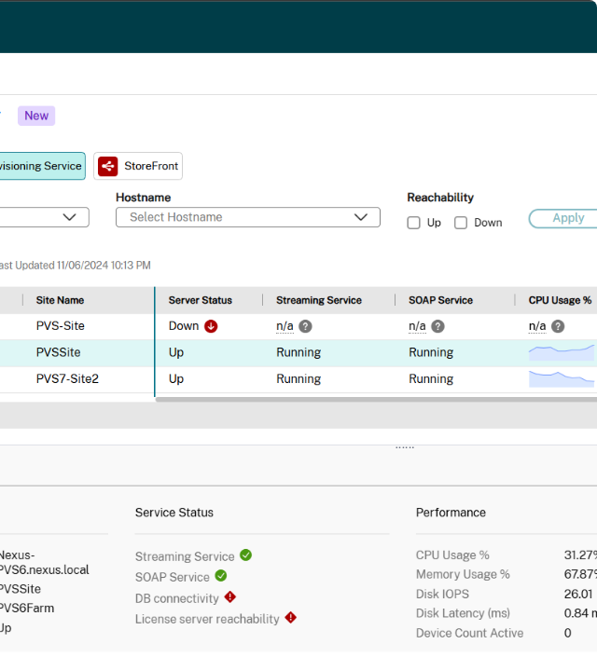
Stage 5: Staging
The Production Mirror
Staging is a production-like environment where the final artifact is deployed for validation.
This is where we test configuration, migrations, and environment-specific variables before the final release.

Slide 10
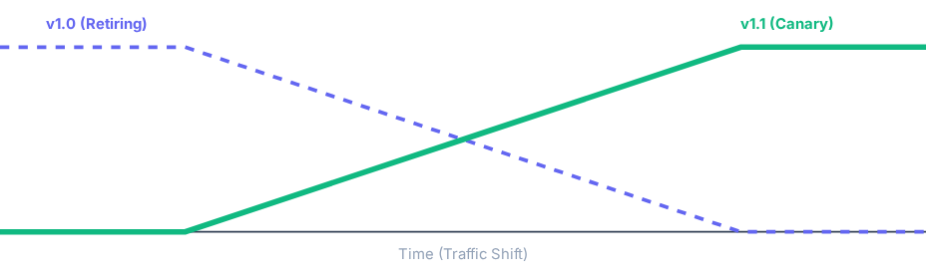
Stage 6: Progressive Delivery
Canary Deployment Traffic Shift
Traffic is gradually shifted from the old version to the new version. If error rates spike, the pipeline triggers an automated rollback.

Slide 11




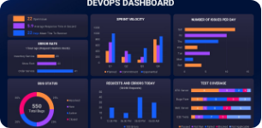


Stage 7: Continuous Monitoring
Logging: Centralized logs to trace errors across microservices.
Alerting: Instant notification when KPIs breach defined thresholds.
Metrics: Real-time tracking of CPU, memory, and latency.

Slide 12
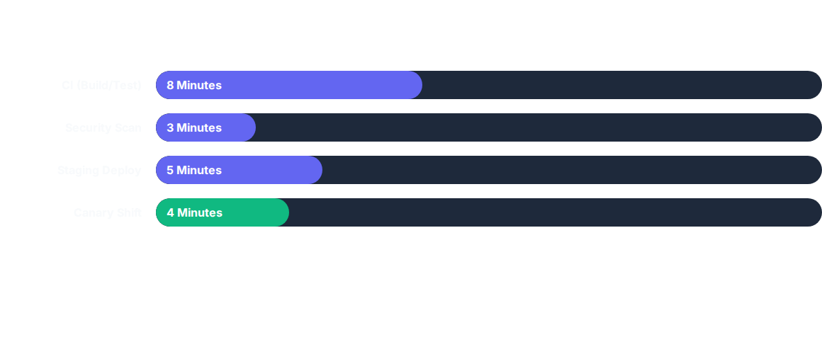
Total Lead Time to Production
Total Journey: 20 Minutes from Commit to Customer

Slide 13
Manual vs. Automated Delivery
Metric | Manual (Traditional) | Automated (Modern)
Deploy Frequency | Once per month | Multiple times per day
Lead Time | Weeks | Minutes
MTTR | Hours/Days | Minutes (Auto-rollback)
Change Failure Rate | High (>20%) | Low (<5%)

Slide 14






Core CI/CD Principles
Automate Everything
Fail Fast
Version Control
Break the build early. Cheap failures in CI prevent expensive failures in Prod.
Code, config, and infra must all be versioned as part of the pipeline.
If a human has to touch the process, it's a bug that needs fixing.

Slide 15
Building Your Pipeline Roadmap
Step 4: Automated Deploy
Step 2: Automate Build
Step 6: Continuous Opt
Step 1: Version Control
Step 3: Unit Testing
Step 5: Monitoring
Don't build everything at once. Start with the "Build" and "Test" phases to gain immediate confidence.

