Slide 1

From Chaos to Control
A Blueprint for Scalable AWS Security: Network, Identity, and IaC
Mohammad Abu Mattar
Cloud Architect & Security Specialist

Slide 2

The Challenge of Security at Scale
Configuration Drift
Visibility Gap
Manual updates lead to inconsistent environments. "Staging" and "Production" security settings diverge over time, creating hidden vulnerabilities.
Scaling to dozens of accounts makes centralized logging and threat detection nearly impossible without specialized multi-account tools.
Manual Bottlenecks
Blast Radius
Security teams become a bottleneck for developers, leading to shadow IT or bypassing controls for the sake of speed.
Poorly defined boundaries mean a single compromised credential or misconfigured security group can affect entire business units.

Slide 3
Why Traditional Security Fails
Fragmented Ownership: Different teams configuring local environments without central standards.
Non-Standard Baselines: Every VPC having a different "standard" for entry/exit points.
Manual Review Cycle: Security verified at the end of a sprint rather than during the build phase.
Policy Inconsistency: IAM policies and SCPs applied haphazardly across accounts.

Slide 4






The Three Pillars of Scalability
Network Security
Identity Layer
Infra as Code
Layered defense from VPC boundaries to specific instances.
Centralized IAM and Least Privilege enforcement.
Automated deployment, versioning, and drift detection.

Slide 5

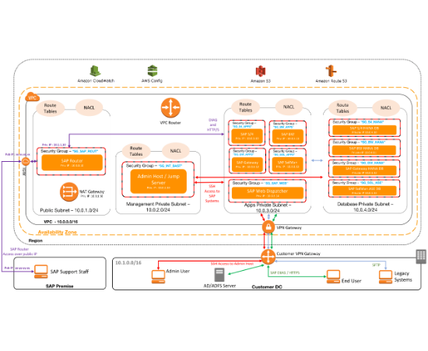
Foundations: Layered Networking
Defense in Depth
1. VPC Boundaries: Strict ingress/egress CIDR blocks.
2. Network ACLs: Stateless subnet protection.
3. Security Groups: Stateful instance-level rules.
Combining these layers ensures that even if one control fails, others remain to mitigate risk.

Slide 6
Security Groups: The Last Mile
Stateful Enforcement: Return traffic is automatically allowed, simplifying rule sets.
ENI Attachment: Acts at the interface level, providing micro-segmentation capabilities.
Allow Rules Only: Implicitly denies everything else, following zero-trust principles.
Reference-able: Allows rules based on other Security Groups (e.g., LB to App).

Slide 7
NACLs: Stateless Protection
Stateless Filter: Must explicitly allow both inbound and outbound traffic.
Subnet-Level: Applies to all resources within the subnet, creating a perimeter.
Ordered Execution: Rules processed from lowest to highest; first match wins.
Deny Capability: Ideal for blocking specific malicious IP ranges or known bad actors.

Slide 8
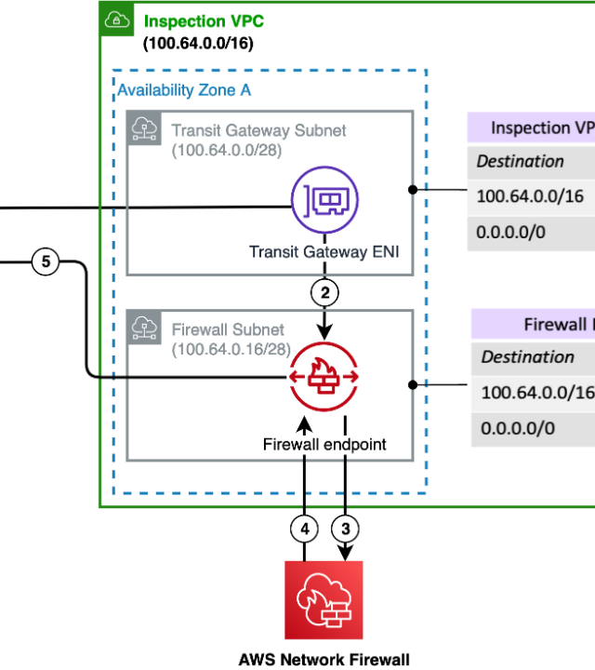
AWS Network Firewall
Advanced L3-L7 Protection
Goes beyond port/protocol filtering with deep packet inspection (DPI).
Domain/FQDN Filtering
Intrusion Prevention (IPS/IDS)
Centralized Inspection Pattern

Slide 9
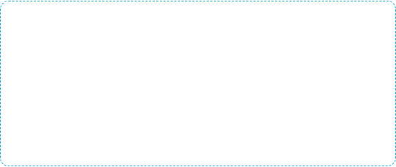
AWS Firewall Manager
Global Policy Enforcement
Compliance Summary
Scaling security requires central authority. Firewall Manager allows you to:
100+ Accounts Secured
Push WAF/SG/Firewall policies to all accounts.
Zero Manual SG Creation
Monitor non-compliance in real-time.
100% Policy Consistency
Automatically remediate drift.

Slide 10
Identity: The Real Control Layer
In modern cloud environments, the identity is the new perimeter. Access management is the most critical security control.

Slide 11






IAM Scaling Best Practices
Use Roles
Enforce MFA
Access Analyzer
Eliminate long-term access keys. Use IAM Roles with OIDC or SSO.
MFA must be mandatory for all human identities and console access.
Continuous monitoring to detect unintended public or cross-account access.

Slide 12
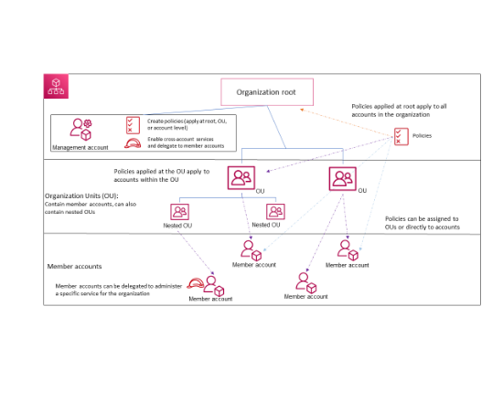
Enforcing Global Guardrails
SCPs & Boundaries
Service Control Policies (SCPs): Define the maximum available permissions for an account. Prevent disabling of CloudTrail or GuardDuty.
Permission Boundaries: Delegate IAM management to developers while ensuring they cannot escalate their own privileges.

Slide 13
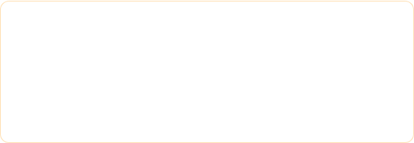
The Failures of the Console
Untraceable Changes
No Rollback
Who changed the SG rule at 3 AM? Without IaC, audit logs in CloudTrail are reactive, not proactive.
Misconfigured a policy? Manual restoration is slow and error-prone compared to a simple git revert.
Inconsistent Env
Human Error
Scaling to 50 accounts manually is impossible. Drift is guaranteed without automated baselines.
Typing a CIDR block wrong (0.0.0.0/0 vs 10.0.0.0/8) leads to instant high-risk exposure.

Slide 14
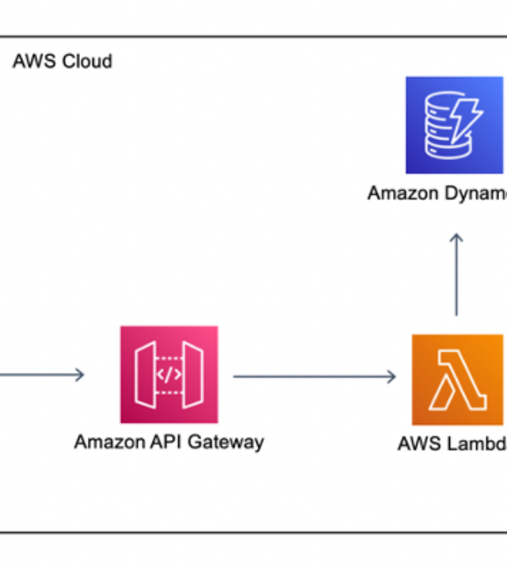
Terraform for Security
Infrastructure as Code
Transform security policies into versioned, reviewable, and repeatable artifacts.
PR Reviews: Peer review all SG changes.
State Management: Single source of truth.
Preview: Run 'terraform plan' to see impact.

Slide 15

Scaling Terraform Environments
Folder-Based
Workspaces
Explicit separation (env/prod, env/dev). Highly visible, distinct state files, and clear hierarchy.
Managed via CLI. Uses same code for all envs. State is stored together but isolated by name.
Best for: Complex environments.
Best for: Identical dev/stage copies.

Slide 16






The Modular Security Pattern
Shared Modules
Variable Injection
CI/CD Logic
Standardize security group templates and IAM roles in central git repos.
Use .tfvars files to differentiate env CIDR blocks and naming conventions.
Central pipeline (GitLab/GitHub Actions) for policy-as-code linting and deployment.

Slide 17
Three Principles of Scale
01
The Control Blueprint
1. Centralize Policy, Distribute Enforcement: Manage rules via Firewall Manager, but let them run at the VPC edge.
Centralize Policy
2. Everything as Code: If it's not in Git, it doesn't exist. Automate baselines for all new accounts.
02
3. Identity-First: Shift from network perimeters to strong identity validation (Zero Trust).
Security as Code

Slide 18
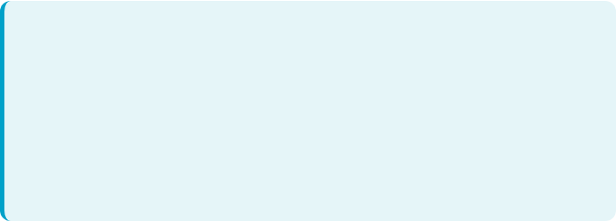
From Chaos to Control
Scalable AWS Security is a continuous journey, not a project.
Action Items:
•
Adopt AWS Firewall Manager for multi-account consistency.
•
Migrate all Security Groups and IAM Roles to Terraform Modules.
•
Enforce Identity Federation and MFA across the organization.
Thank You! | Questions?
Contact: Mohammad Abu Mattar

